Slide 1
For-hired Vehicle (FHV)
Operation Analysis
Kenneth (Haoyu) Cheng, Srilekha Ganga
ALY 6110
Prof. Daya R.

Slide 2
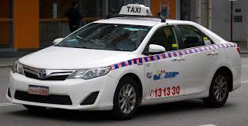
Overview
NYC has over 107,000 active for-hire vehicles (FHVs), including Uber, Lyft, taxis, black cars, and livery cars.
The NYC Taxi & Limousine Commission (TLC) regulates these services to balance availability, fairness, and efficiency
Challenges in the Industry:
Market Concentration: Uber dominates, leaving smaller competitors with fewer resources.
Accessibility Issues: Wheelchair Accessible Vehicles (WAVs) account for less than 1% of the total fleet.

Slide 3
Data Selection
Dataset: NYC Active For-Hire Vehicles (FHV) – NYC Open Data (Imported through API and MongoDB)
Source: TLC - Taxi & Limousine Commission & NYC Open Data
Size & Attributes:
107,000 rows and 23 columns, capturing key vehicle and licensing details.
Data updated daily, making it a valuable real-time resource.
Key Features Analyzed:
Vehicle type (black car, livery, luxury)
Production year (old vs. new vehicles)
License expiration date (future fleet planning)
Wheelchair accessibility (compliance with NYC regulations)
Base affiliation (Uber, Lyft, or independent operators)
Why This Dataset?
Provides real-time insights into fleet composition and accessibility.
Helps analyze FHV market trends, competitive landscape, and sustainability challenges.

Slide 4
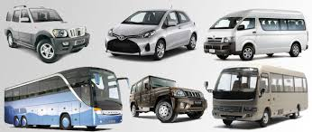
Research Questions
Based on the preview to the data, we are interested in the following questions:
What is the major composition of FHVs?
Which companies dominate the market?
How accessible are these services for wheelchair users?
What trends exist in vehicle registrations and renewals?

Slide 5
Methodologies
MongoDB: Stored and managed the dataset for structured analysis.
Apache Spark: Processed large-scale data efficiently, handling missing values and filtering irrelevant records.
Tableau & Power BI: Created interactive dashboards for data visualization and analysis.
Data Cleaning & Processing Steps:
Converted API-extracted data into a structured database.
Removed duplicate or inconsistent records.
Standardized date formats and categorical variables.
Created additional features for deeper insights (e.g., age of vehicle, upcoming license renewals).
Exploratory Data Analysis (EDA):
Used box plots and violin plots to compare vehicle distributions.

Slide 6
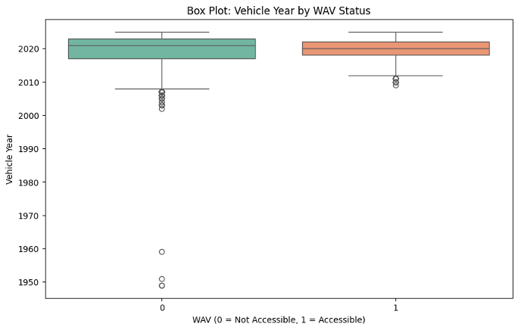
EDA - Boxplot
The box plot reveals that Wheelchair Accessible Vehicles (WAV) are generally newer, with most models between 2012 and 2023. Non-WAV vehicles have a wider age range, including older models with outliers as far back as the 1950s and 1960s.

Slide 7
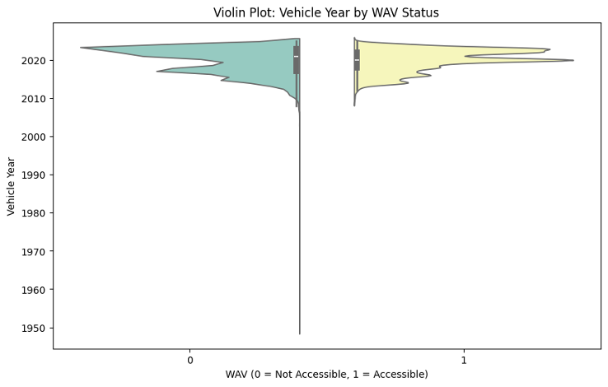
EDA - Violin Plot
The violin plot shows that Wheelchair Accessible Vehicles (WAV = 1) are newer, with a concentrated distribution around post-2010 models, likely due to regulations.
Non-accessible vehicles (WAV = 0) have a broader, more diverse age range, including older models from the 1950s. The plot highlights density differences effectively.

Slide 8
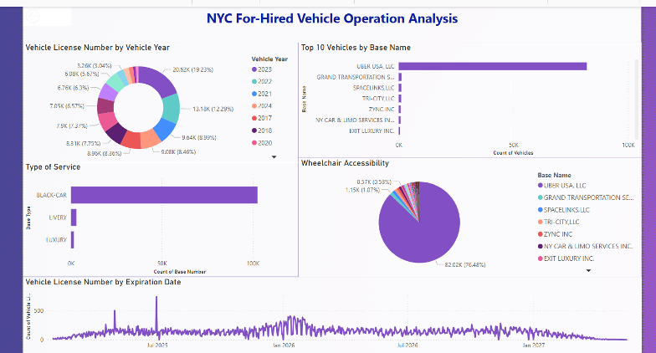
Dashboard

Slide 9
Predictive Modeling – Improving FHV Accessibility
Objective: Use machine learning to predict WAV classification and optimize deployment.
Models Used:
Ridge Regression:
Accuracy: 93% but completely failed to predict WAVs.
Class imbalance caused 0% recall for WAV classification.
Lasso Regression:
Accuracy: 56% but many false positives.
F1 Score for WAV classification: 11.04% (poor performance).
Confusion Matrix:
Ridge: Classified all WAVs as non-WAVs (severe bias).
Lasso: Identified some WAVs but had many false positives.
Implications:
Better data balancing needed (resampling techniques).
Alternative models (decision trees, XGBoost) should be explored.

Slide 10
Conclusion
Market Concentration:
Uber dominates NYC’s FHV market, holding 76% of the total fleet with over 82,015 vehicles.
Other companies, including Lyft and local black car services, have significantly smaller shares, creating a competitive imbalance.
Accessibility Gaps:
Only 7,529 Wheelchair Accessible Vehicles (WAVs) exist in NYC (~0.73% of all FHVs).
WAVs are concentrated in newer model years (post-2010) due to regulatory requirements, but overall, their availability is insufficient to meet demand.
This suggests that passengers with mobility challenges face major barriers when using FHV services.
Predictive Modeling Challenges:
Ridge and Lasso Regression models struggled to accurately classify WAVs due to severe class imbalance in the dataset.
Ridge Regression achieved a 93% accuracy, but it completely failed to predict WAV vehicles (recall = 0%).
Lasso Regression identified some WAVs but had many false positives, leading to unreliable classification.
Future research should explore alternative techniques like decision trees, XGBoost, or deep learning models to improve classification.

Slide 11


Recommendation
Increase WAV Availability:
Provide financial incentives to drivers adopting WAVs.
Partner with government and advocacy groups for funding.
Optimize Fleet Distribution:
Deploy more WAVs in underserved neighborhoods using historical trip data.
Improve app-based WAV booking for convenience.
Enhance Sustainability:
Accelerate electric vehicle adoption through subsidies.
Use license renewals to enforce eco-friendly policies.
Improve Data Collection & Transparency:
TLC should release real-time demand data for better forecasting.

Slide 12
Q&A

Slide 13
Reference
New York City Taxi and Limousine Commission. (n.d.). For-Hire Vehicles (FHV) - Active [Data set]. NYC Open Data. Retrieved February 9, 2025, from https://data.cityofnewyork.us/Transportation/For-Hire-Vehicles-FHV-Active/8wbx-tsch
Apple. (n.d.). Accessibility icon [Image]. Apple Developer. http://developer.apple.com/assets/elements/icons/accessibility/accessibility-128x128_2x.png

Slide 14
Thanks for your patience!

